Slide 1
Network Intrusion Detection System over OpenFlow
By: Team Avengers

Slide 2


Motivation
Attacker 1
DDoS Packet
DDoS Packet
DDoS Packet
DDoS Packet
DDoS Packet
DDoS Packet
DDoS Packet
DDoS Packet
Attacker 2
SERVER
DDoS Packet
DDoS Packet
DDoS Packet
DDoS Packet
DDoS Packet
DDoS Packet
DDoS Packet
DDoS Packet
Attacker 3
DDoS Packet
DDoS Packet
DDoS Packet
DDoS Packet
DDoS Packet
DDoS Packet
DDoS Packet
DDoS Packet
Client
Legitimate
Packet
Legitimate
Packet

Slide 3



Problem
Attack classification and prevention
Server stops responding to legitimate packets
Existing methods – Too much overhead on collecting traffic information
Solution
OpenFlow
SERVER

Slide 4
Project Overview
Packet 1
N ode 1
N ode 3
Packet 2
TCP Flood ?
Pkt flow
Pkt flow
usRTR
POX
TCP Flood Packet
Malicious Packet
N ode 2
N ode 4

Slide 5


Attack Patterns
echo request
destination IP = broadcast
smurf
ICMP
packet count = Large, flow size = Large
ICMP Flooding
source IP = destination IP
destination IP = broadcast
land
TCP
Packet count = Large, flow size = Large
TCP Flooding
destination port = reflecting port
Source port = reflecting port
ping-pong
UDP
packet count = Large, flow size = Large
UDP Flooding

Slide 6




Classification variables
Number of Packets
Number Of
Bytes
Duration
Protocol
IP SRC
IP DST
SRC Port
DST Port
1
3
6
avg(packets)
avg(duration)
growth(ports)
4
n(pair flows)
2
avg(packet size)
5
growth(single flows)

Slide 7

Steps to prevent DDoS
Step 1: Train the NDIS using a training data set
Apply Naïve Bayes Theorem
10.1.1.1
10.1.1.2
Training data
set of network
traffic
Flow
Table
DDOS Detection
System
Open vSwitch
Controller
10.1.1.3
10.1.1.4

Slide 8

Step 2: Collect flow statistics periodically at controller
Protocol
IP SRC
IP DST
TCP/UDP SRC Port
TCP/UDP DST Port
No. Of Packets
No. Of Bytes
Duration
Action
DDOS Detection
System
10.1.1.1
Flow
Table
10.1.1.2
Flow entry
Open vSwitch
OFP Stats Request
Controller
10.1.1.3
10.1.1.4
Notes:
Alignment change

Slide 9
Step 3: Classify attack, take action
DDOS Detection
System
10.1.1.1
Flow
Table
10.1.1.2
OFPFC_DELETE
Flow Mod Request
Open vSwitch
Controller
10.1.1.3
10.1.1.4

Slide 10
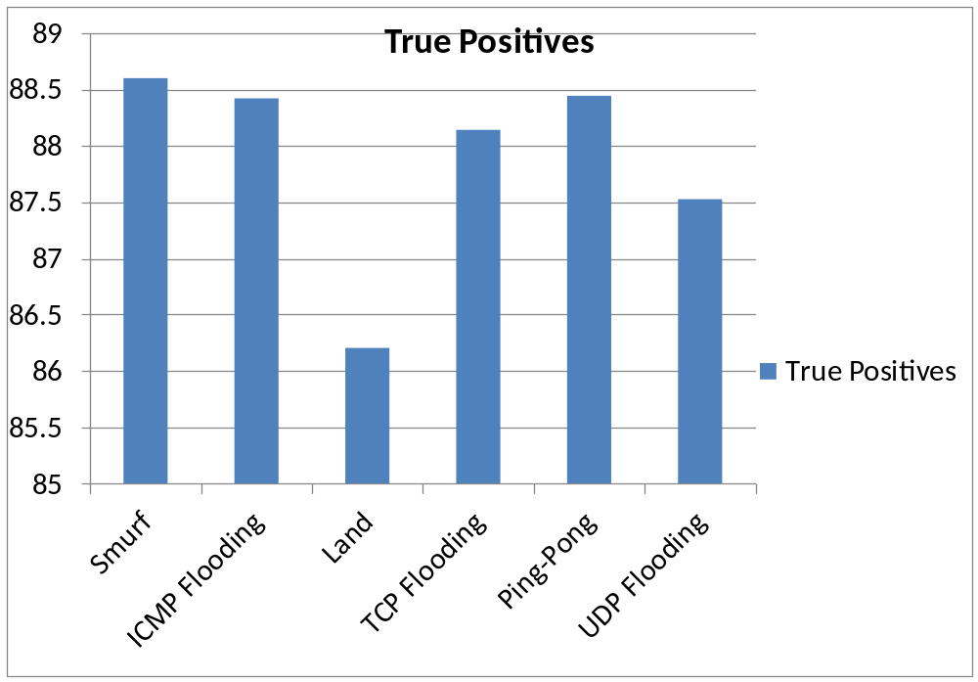
Experiment Results

Slide 11
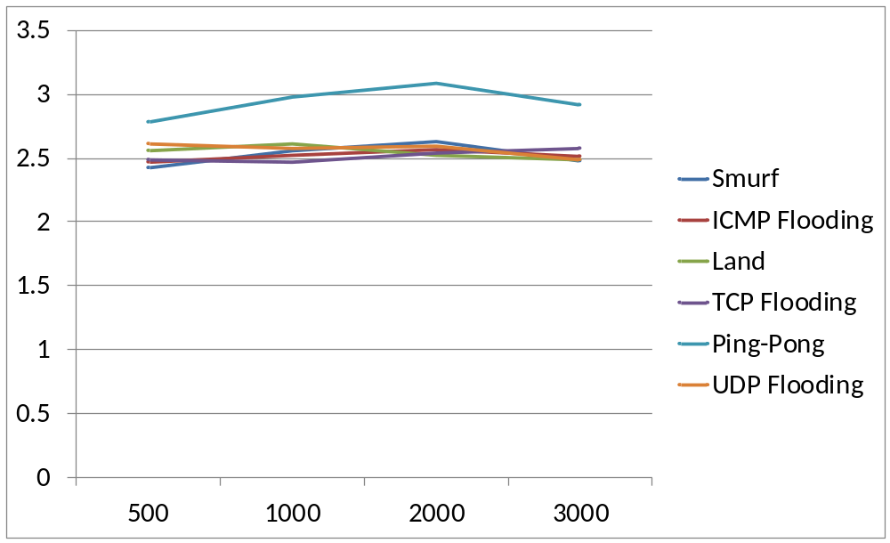
Rate of False Positives
Rate
No. of flow sample

Slide 12
Advantages, Limitations and Alternatives
Advantages
  Easy to implement
  Reduced overhead
  Scalable
Disadvantages
  Assumption of class conditional independence
  Dependencies among these cannot be modeled
  Every packet cannot be analyzed
  Processing Overhead
Alternatives
  SVM – high time and space complexity
  Neural Networks
Notes:
Disadv
Not all packets can be analyzed for payload rules esp for bursty traffic
But if all packets are analyzed – processing overhead

Slide 13
Achieved so far!
Implement the NIDS system on OpenFlow .
Implemented Naïve Bayes Classifier to classify various kinds of attacks.

Slide 14
Further Developments
Random Forest classification of various kinds of attacks.
Collaborative intrusion detection on OpenFlow.

Slide 15
RF- Building the Model Forest
Training Data Points
(‘M’ Predictor Variable & Class)
Repeat until the tree is grown to full extent.
Randomly selects ‘m’ statistics(m<<M) to split data
One classification tree
Repeat for the number of trees that user has specified
Model “Forest”

Slide 16













Building Random Forest
Training Data Points
(‘M’ Predictor Variable & Class)
Randomly selects ‘m’ statistics(m<<M) to split data
One classification tree
Model “Forest”

Slide 17
Attack Classification Example
Normal : 64%
Smurf: 12%
……..
……..
N in the tree: 1000
PROTOCOL
UDP
TCP
ICMP
Fraggle : 20%
Normal: 67%
Ping-Pong: 7%
…….
Land: 12%
TCP Flood: 30%
Normal: 50%
……
.
Smurf: 17%
ICMP Flood: 30%
Normal: 23%
…..
No. of Packets
No. of bytes
No. of packets
S
S
S
L
L
L
Fraggle: 12%
Normal:47%
…..
…..
UDP Flood: 60%
Normal:30%
……
……
Land: 14%
Normal: 50%
…..
…..
TCP Flood: 14%
Normal: 54%
…..
…..
Smurf: 34%
Normal: 56%
…..
…..
ICMP Flood: 40%
Normal: 30%
…..
…..

Slide 18
References
“Lightweight DDoS Flooding Attack Detection Using NOX/OpenFlow”
  by: Rodrigo Braga, Edjard Mota andAlexandre Passito
“Online classification of Network Flows”
  by: Mahbod Tavallaee, Wei Lu and Ali A. Ghorbani

Slide 19
Schedule
Achieved so far –
  Completed implementation of Naïve Bayes classifier
  Obtained preliminary results
  Simulated different kinds of attacks
To Do -
  Complete implementation of Random Forest
  Experiment and find optimal value of ‘m’
  Comparison between the NB and RF

Slide 20
Thank You!
Questions?

